Slide 1


Linear regression – supervised ML model Lesson 2 by Anna Levant

Slide 2
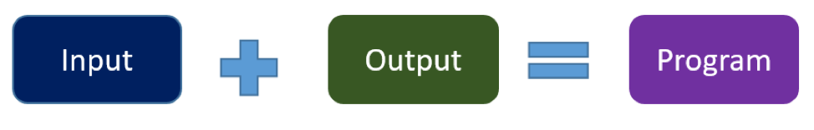
Remember from 1st lecture?
Machine learning:
Notes:
In traditional programming you hard code the behavior of the program. In machine learning, you leave a lot of that to the machine to learn from data.

Slide 3
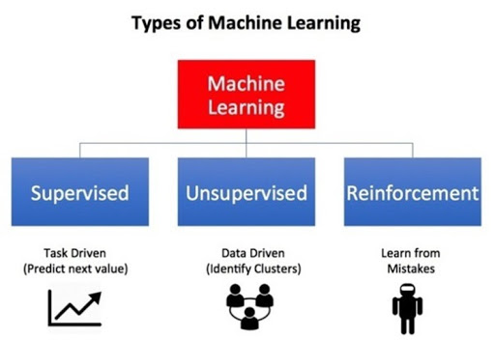

Slide 4
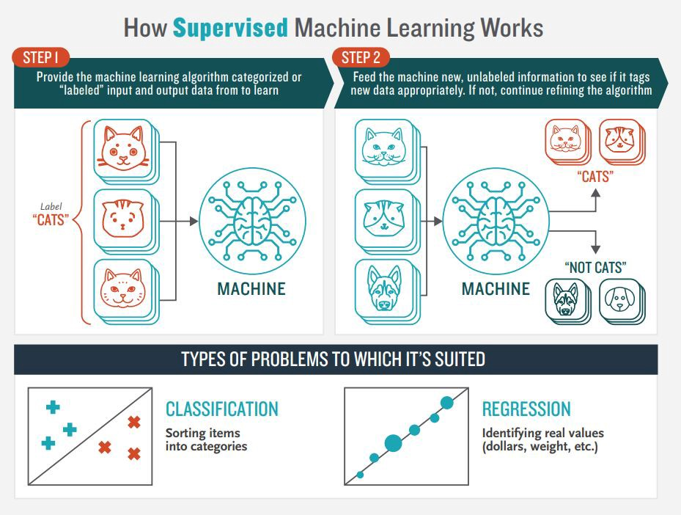
Supervised learning is the machine learning task of learning a function that maps an input to an output based on example input-output pairs

Slide 5
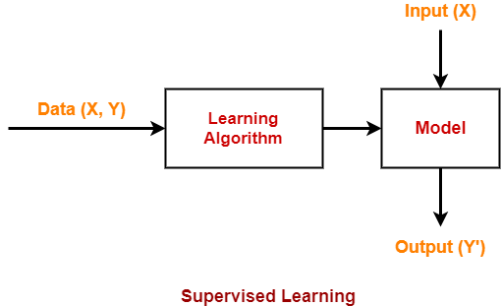
More on “Supervised Learning”
The training data set is a labeled data set.
In other words, the training data set contains the input value (X) and target value (Y)
The learning algorithm generates a model
Then, new data set consisting of only the input value is fed
The model then generates the target value based on its learning

Slide 6
Linear Regression
Linear Regression is a supervised machine learning algorithm.
Thanks to its simplicity interpretability and speed , linear regression is one of the most popular model in ML for real-life problems
The output of the dependent variable of a linear regression model is a continuous value i.e. real numbers.

Slide 7
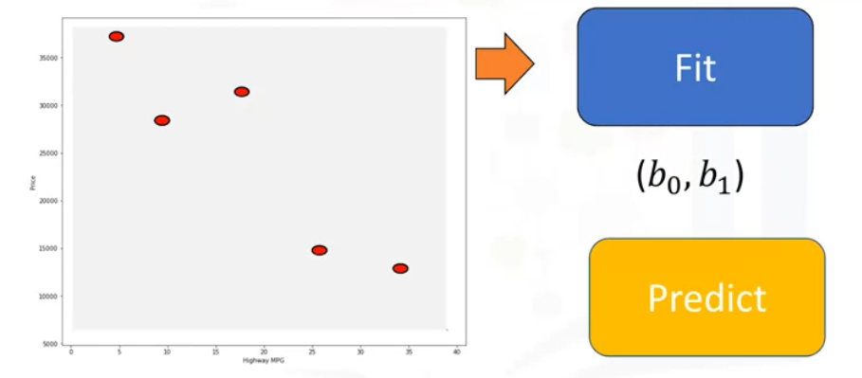
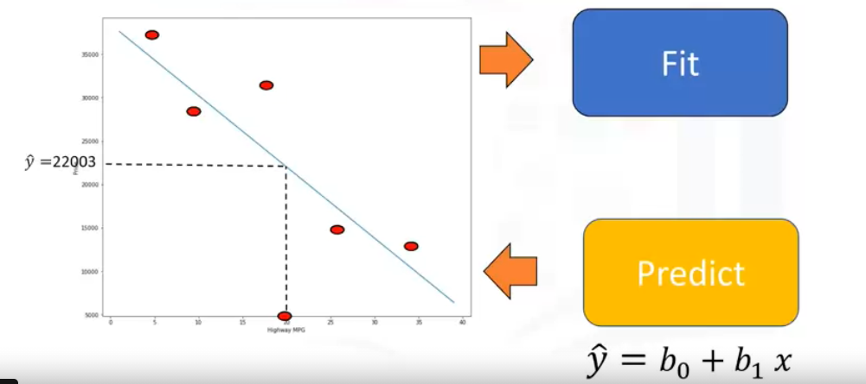
TRAIN
Get observation pairs (x,y)
Get new input x
PREDICT

Slide 8
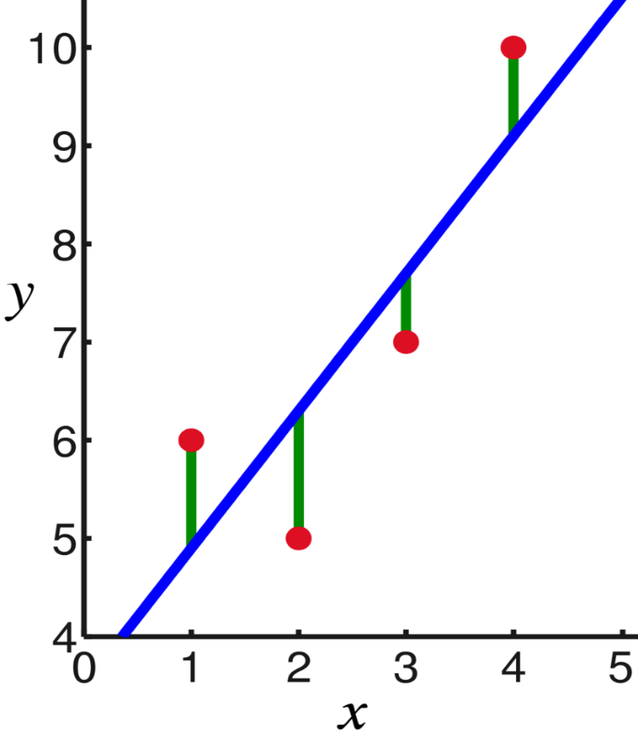
Representing Linear Regression Model
In linear regression, the observations (red) are assumed to be the result of random deviations (green) from an underlying relationship (blue) between a dependent variable (y) and an independent variable (x).
You can think of linear regression as the question:
“How can I use x to predict y?”
dependent variable
independent variable

Slide 9


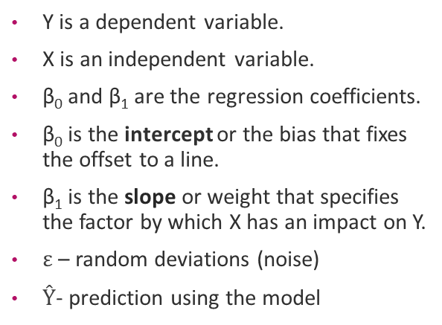
Simple (univariate) Linear Regression
In simple linear regression, the dependent variable depends only on a single independent variable.
For simple linear regression, the form of the model is
Y is a dependent variable.
X is an independent variable.
β₀ and β₁ are the regression coefficients.
β₀ is the intercept or the bias that fixes the offset to a line.
β₁ is the slope or weight that specifies the factor by which X has an impact on Y.
$ε$ – random deviations (noise)
$Ŷ$- prediction using the model
$$Y=β_{0}+β_{1}X+ε$$
$$Ŷ=β_{0}+β_{1}X$$

Slide 10
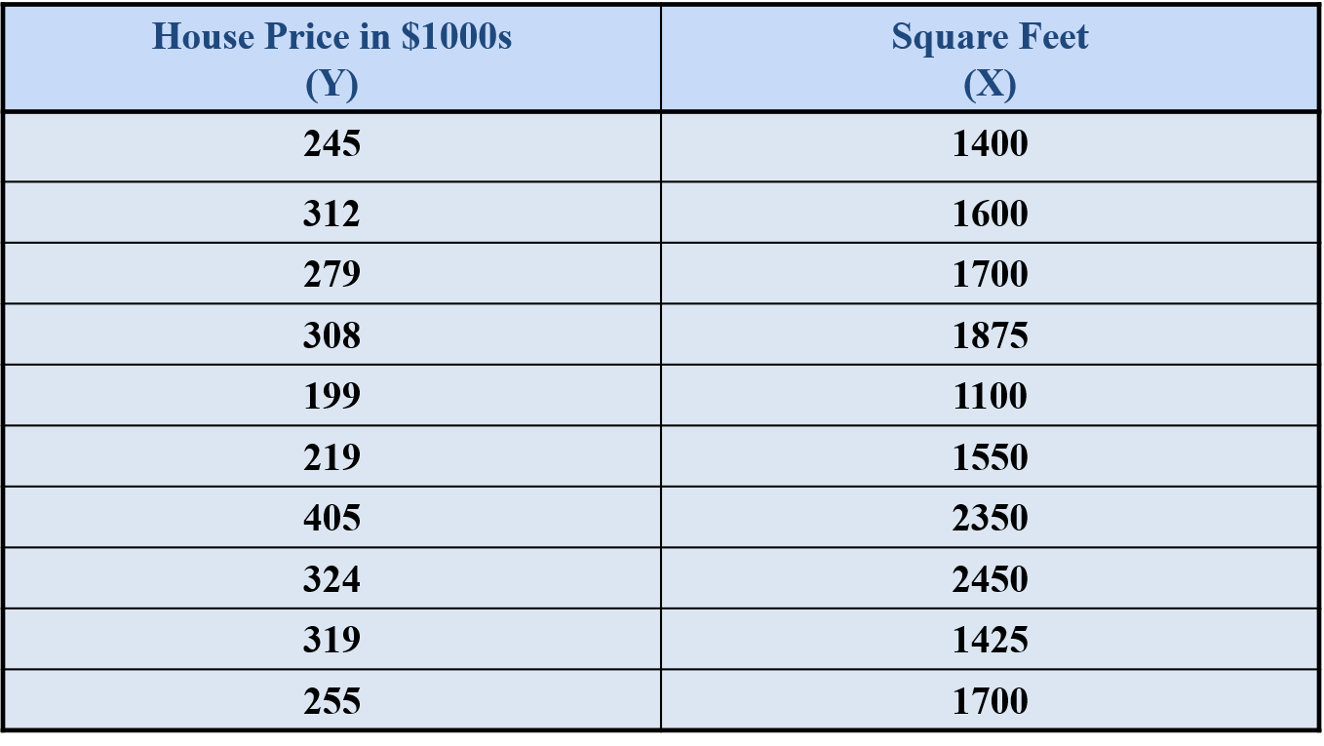
Example: house prices
Let’s look at an example: you would like to know how much you can sell your house for
You have information about some history in your city the size in square feet and the price in $1000 the house was sold
We would like to train our model to estimate the relationship

Slide 11
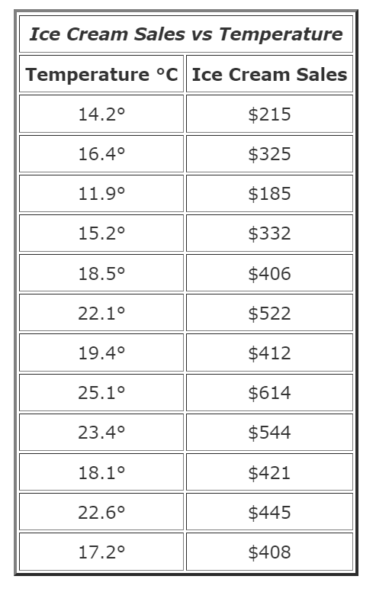
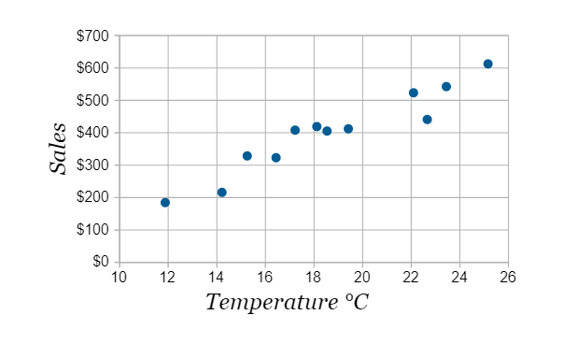
Example: Ice cream sales
Scatter plot
Table data
Warmer weather leads to more sales

Slide 12
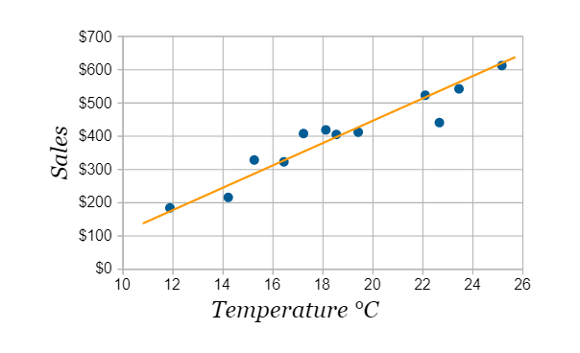



Linear regression fit
data points (X,Y)
$$Y=β_{0}+β_{1}X+ε$$
$$Ŷ=β_{0}+β_{1}X$$
noise
regression line (X, $Ŷ$)
Try to have the line as close as possible to all points - how?

Slide 13
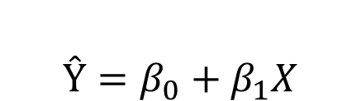
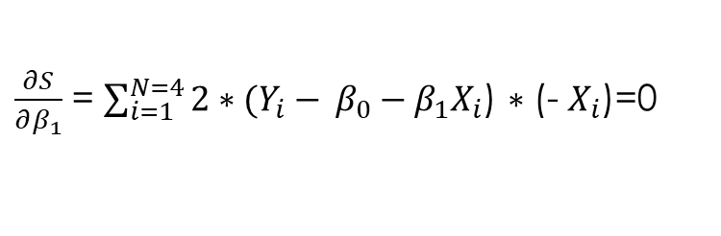
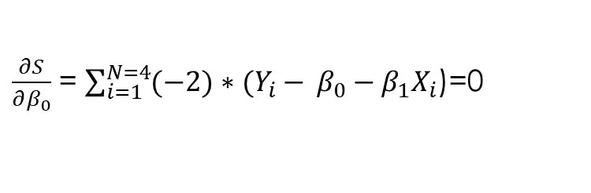
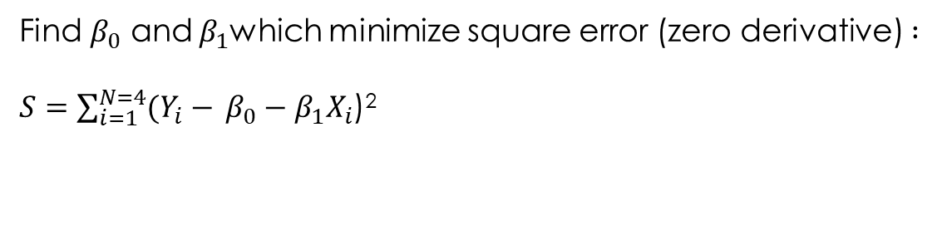

Least square error approach
(x₄,y₄)
Real data:
$$Y=β_{0}+β_{1}X+ε$$
$$Ŷ=β_{0}+β_{1}X$$
Model:
Find $β_{0}$ and $β_{1}$which minimize square error (zero derivative) $:$
$S=\sum_{i=1}^{N=4}{(Y_{i}−} β_{0}−β_{1}X_{i}$)²
(x₁,y₁)
(x₃,y₃)
(x₂,y₂)
$\frac{∂S}{∂β_{0}}$ = $\sum_{i=1}^{N=4}{(−2)∗(Y_{i}−} β_{0}−β_{1}X_{i}$)=0
$\frac{∂S}{∂β_{1}}$ = $\sum_{i=1}^{N=4}{2∗(Y_{i}−} β_{0}−β_{1}X_{i}$) $∗$(- $X_{i}$)=0

Slide 14
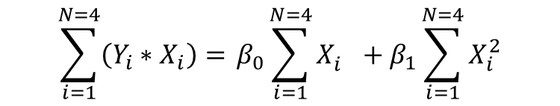

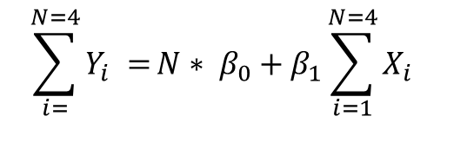
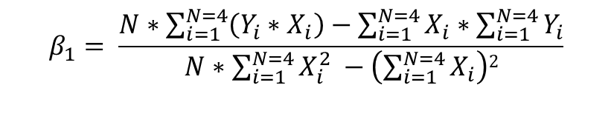
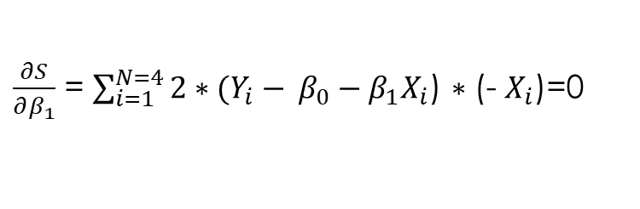
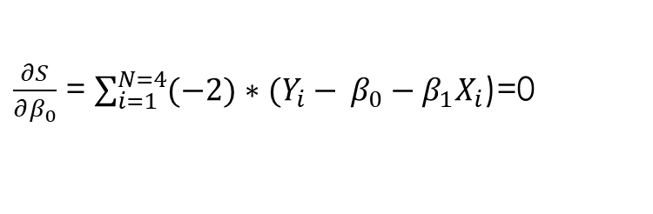
$\frac{∂S}{∂β_{0}}$ = $\sum_{i=1}^{N=4}{(−2)∗(Y_{i}−} β_{0}−β_{1}X_{i}$)=0
$\frac{∂S}{∂β_{1}}$ = $\sum_{i=1}^{N=4}{2∗(Y_{i}−} β_{0}−β_{1}X_{i}$) $∗$(- $X_{i}$)=0
Outliers
Be careful! Least squares is sensitive to outliers. A strange value will pull the line towards it.
$$\sum_{i=}^{N=4}{Y_{i} =}N∗ β_{0}+β_{1}{\sum_{i=1}^{N=4}{X_{i}}}_{}$$
$$\sum_{i=1}^{N=4}{\left(Y_{i}∗X_{i}\right)=} β_{0}\sum_{i=1}^{N=4}{X_{i}^{}}+β_{1}\sum_{i=1}^{N=4}{X_{i}^{2}}$$
$$β_{1}= \frac{N∗\sum_{i=1}^{N=4}{\left(Y_{i}∗X_{i}\right)−\sum_{i=1}^{N=4}{X_{i}}∗\sum_{i=1}^{N=4}{Y_{i}}}}{N∗\sum_{i=1}^{N=4}{X_{i}^{2}} −\left(\sum_{i=1}^{N=4}{X_{i}}\right)2}$$
$$β_{0}= \frac{\sum_{i=1}^{N=4}{Y_{i}}−β_{1}∗\sum_{i=1}^{N=4}{X_{i}}}{N}$$

Slide 15
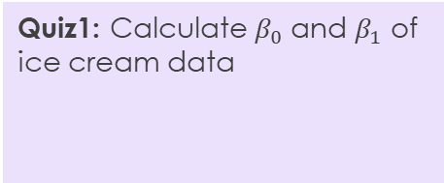
Linear regression fit
data points (X,Y)
$$Y=β_{0}+β_{1}X+ε$$
$$Ŷ=β_{0}+β_{1}X$$
noise
Quiz1: Calculate $β_{0}$ and $β_{1}$ of ice cream data
regression line (X, $Ŷ$)

Slide 16
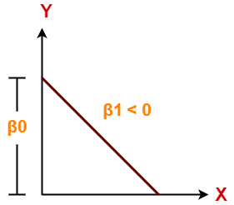
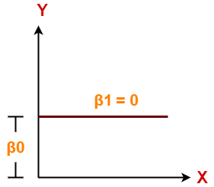
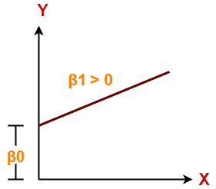

Different cases of linear regression
$$Ŷ=β_{0}+β_{1}X$$
Quiz 2: The temperature has
Negative impact on ice cream sales
Positive impact on ice cream sales
No impact on ice cream sales
.
Variable X has negative impact on Y
There is no relationship between the two variables
Variable X has positive impact on Y

Slide 17


Back to our example
data points
regression line
Let X be square feet vector and Y – house price vector, we can estimate the regression in Python as bellow:
from sklearn.linear_model import LinearRegression
lm=LinearRegression()
lm.fit(X, Y)
b1=lm.coef_
b0=lm.intercept_
Yhat=lm.predict(X)
Slope = 0.10977
Intercept =98.248
$β_{0}$ = 98.248 , $β_{1}$= 0.10977
Quiz 2: Predict the price for a house with 2000 square feet
$$Ŷ=β_{0}+β_{1}X$$
Equation of the regression line

Slide 18
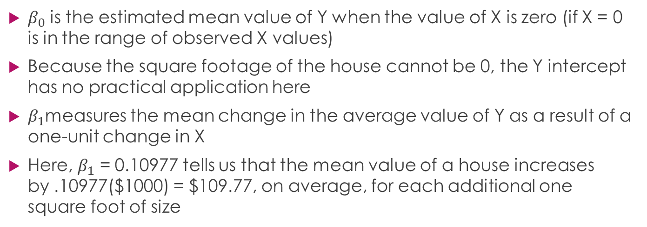

Linear Regression Example Interpretation of $β_{0}$ and $β_{1}$
$β_{0}$ is the estimated mean value of Y when the value of X is zero (if X = 0 is in the range of observed X values)
Because the square footage of the house cannot be 0, the Y intercept has no practical application here
$β_{1}$measures the mean change in the average value of Y as a result of a one-unit change in X
Here, $β_{1}$ = 0.10977 tells us that the mean value of a house increases by .10977($1000) = $109.77, on average, for each additional one square foot of size

Slide 19
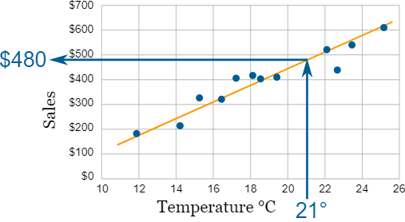
Linear Regression Example Making Predictions: Interpolation
Interpolation is where we find a value inside our set of data points.
Quiz 3: Predict the sales using your model at 13 degrees

Slide 20
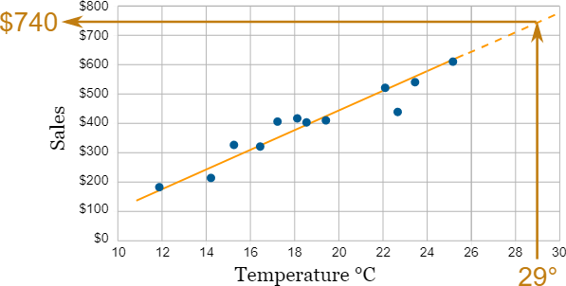
Linear Regression Example Making Predictions: Extrapolation
Extrapolation is where we find a value outside our set of data points
Careful: Extrapolation can give misleading results. When using a regression model for prediction, better to predict only in the relevant range of data
Quiz 4: This is a good idea to use this data to predict sales at -2 degrees
True
False

Slide 21
Linear Regression Example Making Predictions
Relevant range for interpolation
When using a regression model for prediction, only predict within the relevant range of data
Do not try to extrapolate beyond the range of observed X’s
Quiz 3: This is a good idea to use this data to predict for houses of 3000 sq. feet size
True
False

Slide 22

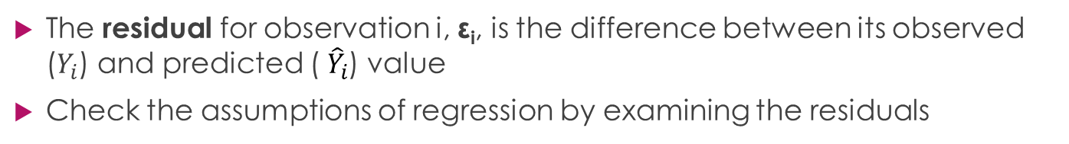
Residual Analysis
$$Y=β_{0}+β_{1}X+ε$$
Quiz 5: Linear model is a good model for ice cream data
True
False
$$ε_{i}=Y_{i}−{ \hat{Y}}_{i}$$
$$Ŷ=β_{0}+β_{1}X$$
The residual for observation i, ε_{i}, is the difference between its observed ($Y_{i}$) and predicted (${ \hat{Y}}_{i}$) value
Check the assumptions of regression by examining the residuals

Slide 23
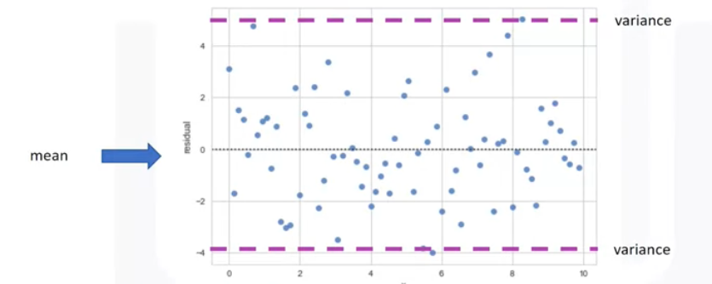
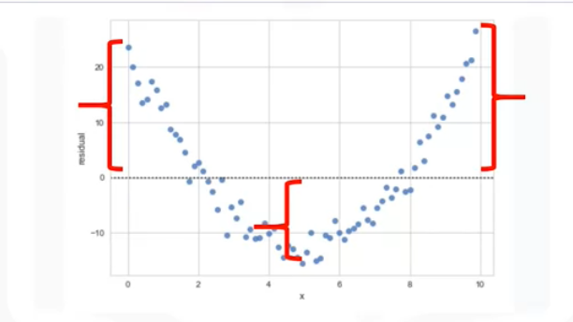
Analysis of residual plot – linear model validity
Look at the spread of the residuals
randomly spread around x-axis – linear model is appropriate
not-randomly spread around x-axis – linear model is not appropriate

Slide 24
How good is the model?
3 important measures to determine fit of the model:
Mean squared error (MSE) – how far is predicted results from the observed?
Coefficient of Determination: R-squared (R2) – how good our model fits the data?
P-value - significance of the regression coefficients – do the coefficients we get are significant?

Slide 25

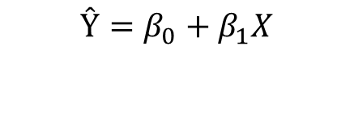


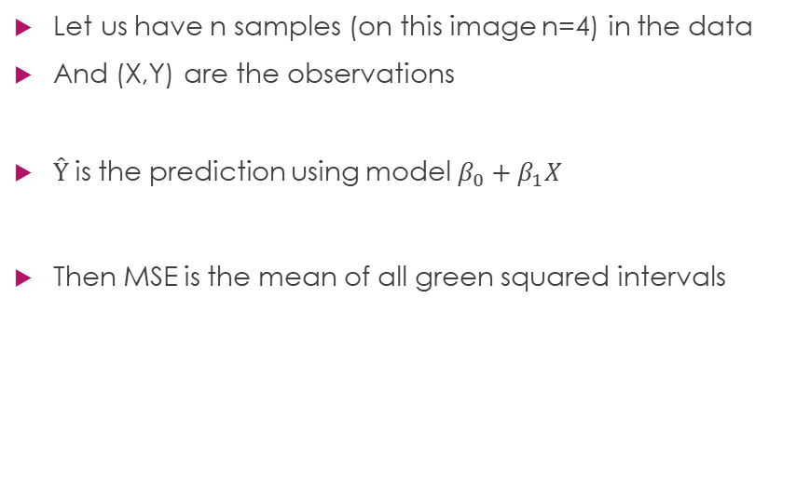
Mean squared error (MSE)
Let us have n samples (on this image n=4) in the data
And (X,Y) are the observations
$Ŷ$is the prediction using model $β_{0}+β_{1}X$
Then MSE is the mean of all green squared intervals
$$Y=β_{0}+β_{1}X+ε$$
$$Ŷ=β_{0}+β_{1}X$$
$$MSE=\frac{1}{n}\sum_{i=1}^{n}{{(Y_{i}−{ \hat{Y}}_{i})}^{2}}$$
Quiz 6: calculate MSE for ice-cream data

Slide 26


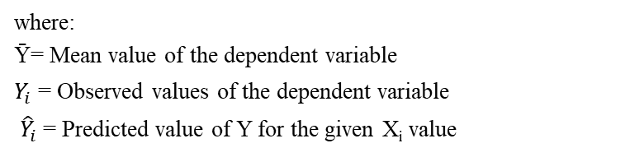
Measures of Variation
SSE
$$\text{SST} = \text{SSR} + \text{SSE}$$
SSR
Sum of Squares Total
Sum of Squares Regression
Sum of Squares Error
Ȳ
where:
Ȳ= Mean value of the dependent variable
$Y_{i}$= Observed values of the dependent variable
${ \hat{Y}}_{i}$= Predicted value of Y for the given X_{i} value
Quiz 6: Calculate for ice-cream data:
SSR
SSE
SST

Slide 27

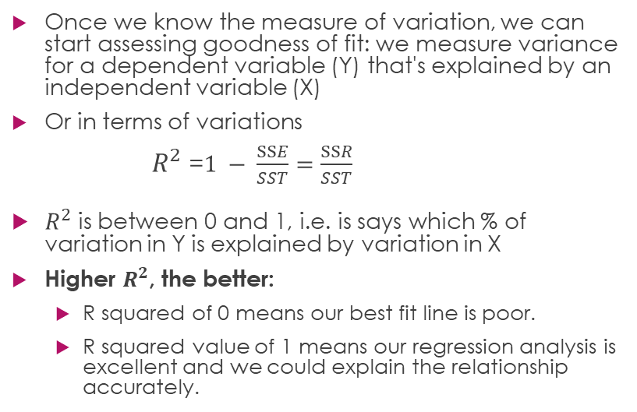
Coefficient of Determination: R²
Once we know the measure of variation, we can start assessing goodness of fit: we measure variance for a dependent variable (Y) that's explained by an independent variable (X)
Or in terms of variations
$R^{2}$ =$1 − \frac{SSE}{SST}=$ $\frac{SSR}{SST}$
$R^{2}$ is between 0 and 1, i.e. is says which % of variation in Y is explained by variation in X
Higher $R^{2}$, the better:
R squared of 0 means our best fit line is poor.
R squared value of 1 means our regression analysis is excellent and we could explain the relationship accurately.

Slide 28
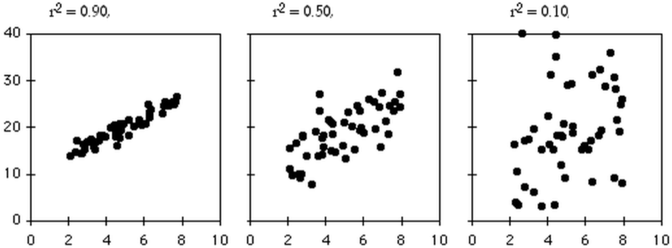
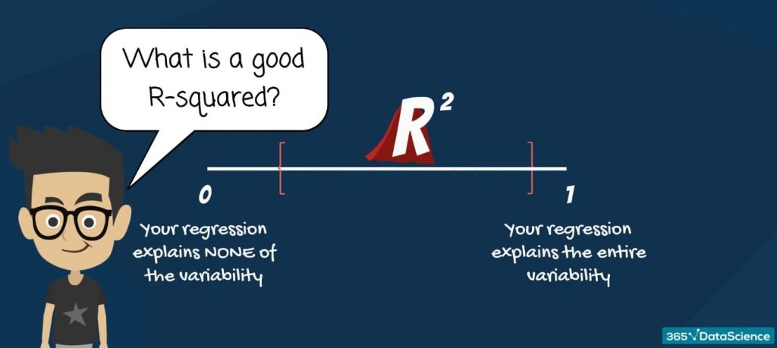

Good vs bad $R^{2}$
In fields such as physics and chemistry, scientists are usually looking for regressions with R-squared between 0.7 and 0.99. However, in social sciences, such as economics, finance, and psychology the situation is different. There, an R-squared of 0.2, or 20% of the variability explained by the model, would be fantastic.

Slide 29
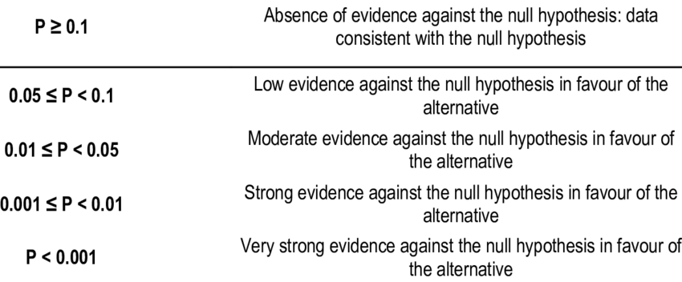
Significance of the regression coefficients (P-value)
Remember we have got that: we would like to check if the slope 0.10977 is significant, i.e. there is a relationship between house price and square feet. For this we check which hypothesis is correct:
H0 – null-hypothesis:
“insignificant – no relationship” =slope is not significant
H1 - alternative hypothesis:
“significant – there is a relationship” = slope is significant
P-value helps us to identify
Quiz 10: Is slope we have found is significant ?

Slide 30
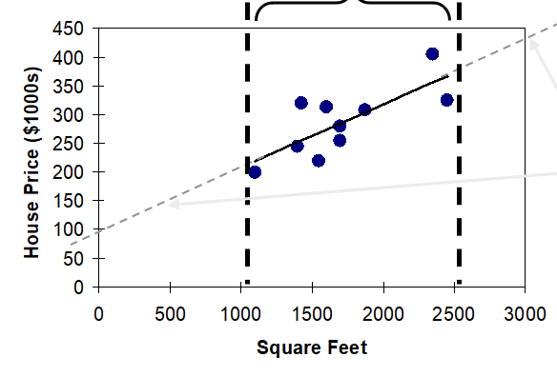
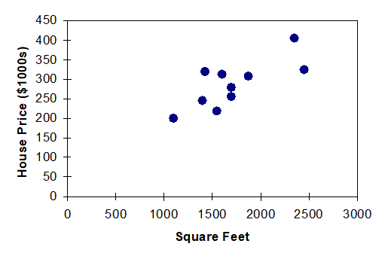
Strategies for Avoiding the Pitfalls of Regression
Start with a scatter plot of X on Y to observe possible relationship
Perform residual analysis to check the assumptions
Plot the residuals vs. X to check for violations of assumptions such as equal variance
If there is violation of any assumption, use alternative methods or models
If there is no evidence of assumption violation, check MSE and R2, then test for the significance of the regression coefficients
Avoid making predictions or forecasts outside the relevant range
MSE
R-squared
P-value

Slide 31
So we learned today:
Linear regression as supervised ML
Simple linear regression with one independent variable
What does coefficients of linear model mean?
Analysis of residuals
Model goodness:
MSE
R2
P-value
Limitations of using linear model

Slide 32
Thank you!

